Slide 1


Slide 2

VEL TECH HIGH TECH DR. RANGARAJAN DR. SAKUNTHALA ENGINEERING COLLEGE An autonomous Institution Department of Computer Science and Engineering
Project Title
WEB PHISHING DETECTION

Slide 3
TEAM DETAILS
TEAM ID: PNT2022TMID21985
Team Leader - ARCHANA M (113019104013)
Member 1 - AADHILAKSHMI A (113019104001)
Member 2 - JAHNAVI D (113019104036)
Member 3 - NAJNEEN BANU (113019104056)

Slide 4


Slide 5
PROBLEM STATEMENT
To distinguish and predict e-banking phishing sites, we proposed an adaptable and compelling framework that depends on utilizing grouping calculations. We executed order calculations and strategies to remove the phishing datasets rules to characterize their authenticity. The e-banking phishing site can be recognized in view of a few significant qualities like URL, space character, security and encryption standards in the last phishing recognition rate. When a client makes an exchange online installment through an e-banking site our framework will utilize an information mining calculation to recognize regardless of whether the e-banking site is a phishing site.

Slide 6
PROPOSED SOLUTION
Web phishing plans to take private data, for example, usernames, passwords, and online payment card details, via mimicking a genuine element. It will prompt data exposure and a property harm. Huge associations might get caught in various types of scams.
To recognize and detect e-banking phishing sites, we proposed an intelligent adaptable and successful framework that depends on utilizing grouping calculations(algorithms). We executed characterization,calculations and methods to extract the phishing datasets models to order their authenticity.

Slide 7
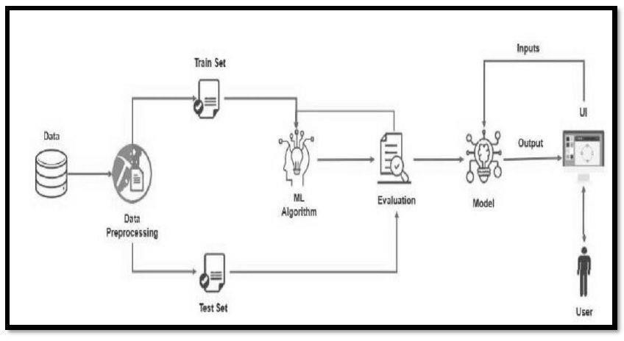
TECHNICAL ARCHITECTURE

Slide 8
WORKING DEMO OF THE PROJECT

Slide 9


Slide 10
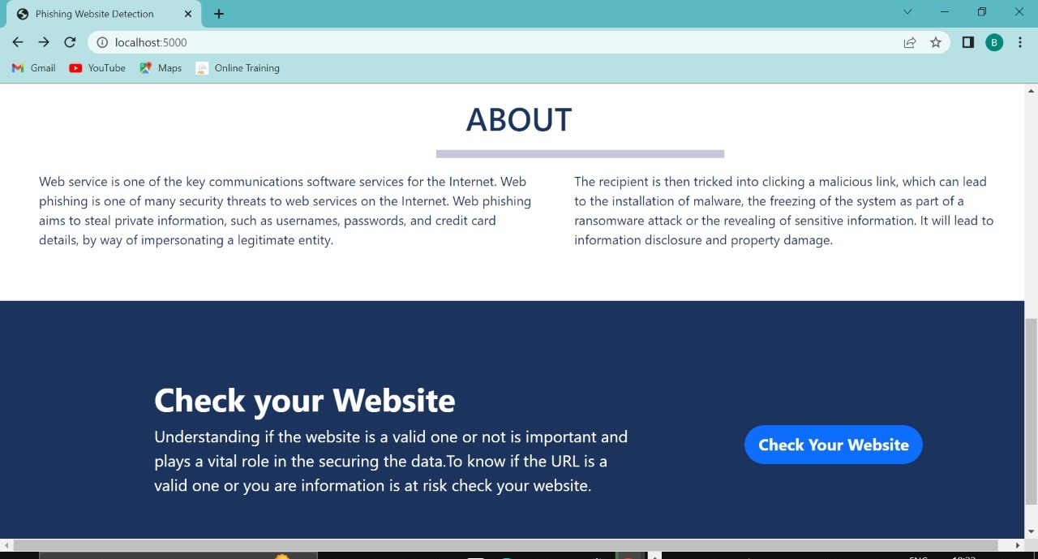

Slide 11
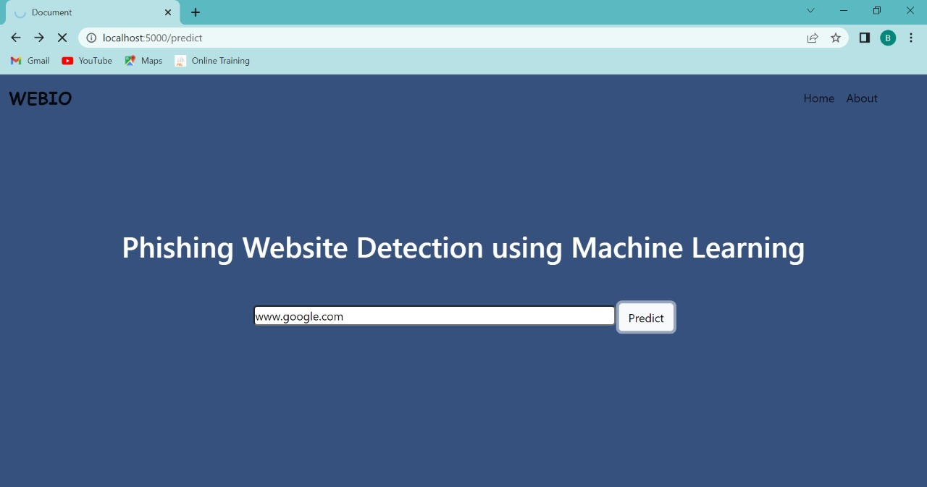

Slide 12


Slide 13
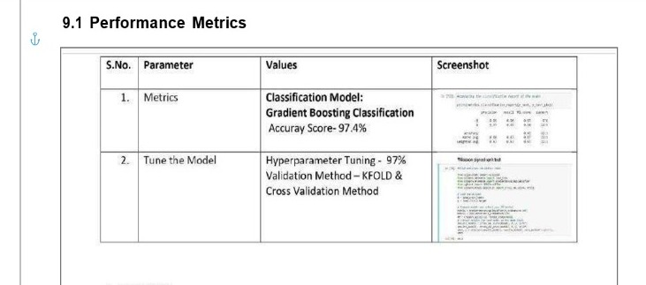
PERFORMANCE AND METRICS

Slide 14
FUTURE SCOPE
There is an scope for future improvement of this implement. We will carry out this utilizing progressed profound learning technique to work on the exactness and accuracy. Upgrades can be done in a proficient way. Consequently, the venture is adaptable and can be upgraded whenever with further advanced features.

Slide 15


